Slide 1
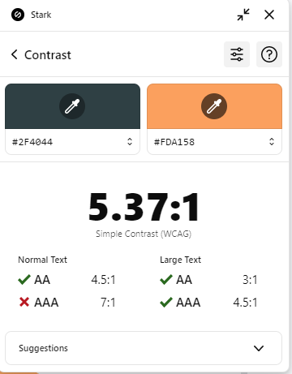
OSC
Science & tech Dot Net Restful API
Khaled Sayed

Slide 2


Table of contents
01
02
03
Foundations
Core Concepts
Implementation
MVC vs API
API Architectures
REST
HTTP
Middleware
Project Structure
CRUD
04
05
06
Security
Tooling
Project Announcements
Auth Methods
JWT
Token Management
Swagger
Postman

Slide 3
01
Foundations
MVC vs API

Slide 4

What’s API?

Slide 5
API
API (Application Programming Interface) is a set of rules, protocols, and tools for building software applications. It specifies how software components should interact and is used to enable the integration between different software systems.

Slide 6
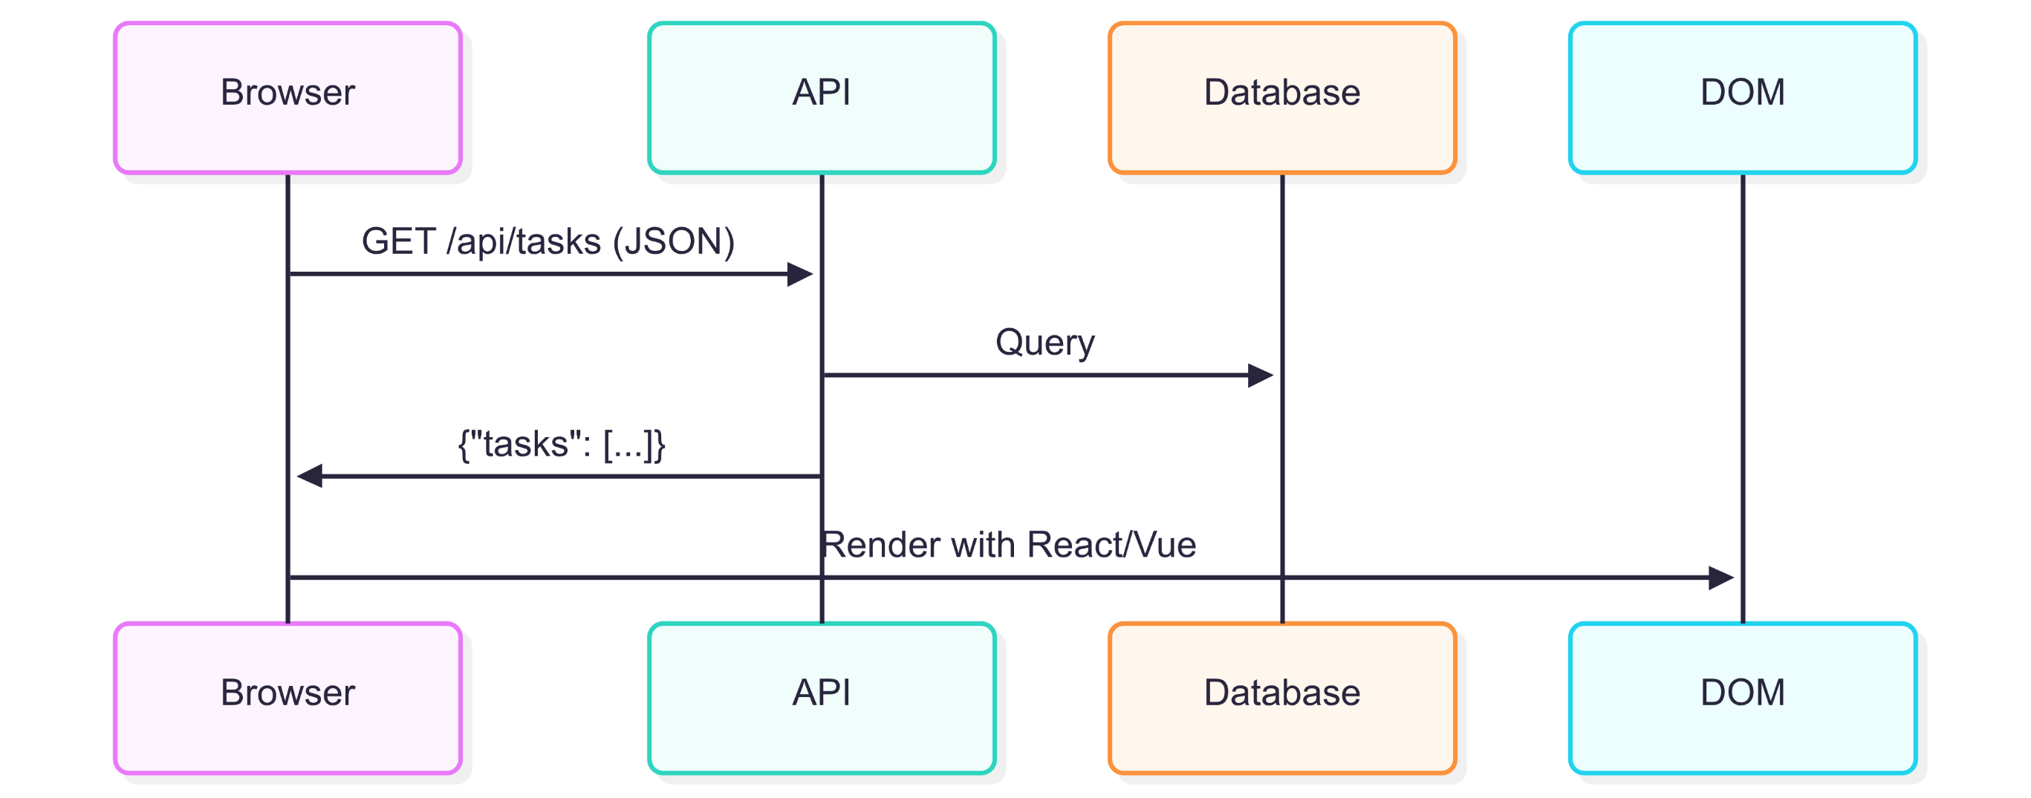
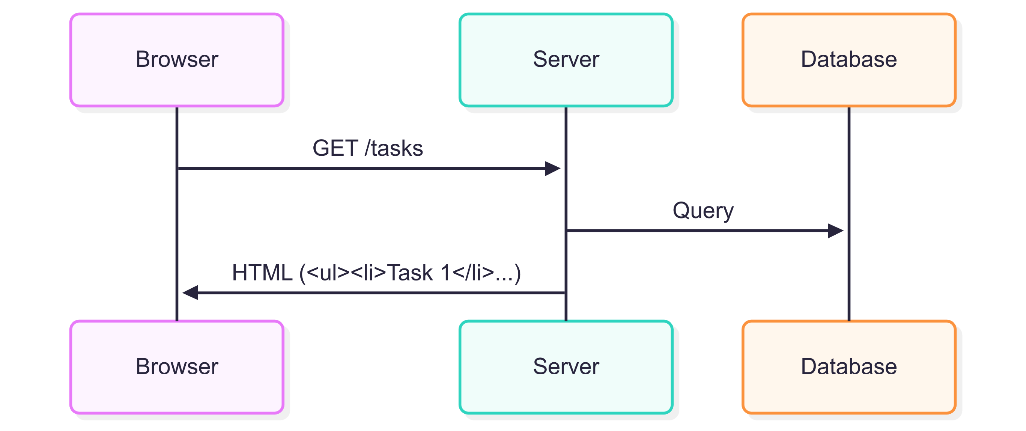
MVC vs API

Slide 7
MVC vs API
Aspect | MVC | API
Composition | Backend + Frontend bundled in one project | Backend only
Output | Returns **HTML views** (with data embedded) | Returns **raw data** (JSON, XML, etc.)
Clients | Primarily **browsers** | mobile apps, IoT, other APIs, ...
Coupling | Tightly coupled (backend - frontend) | Loosely coupled (backend - frontend)

Slide 8
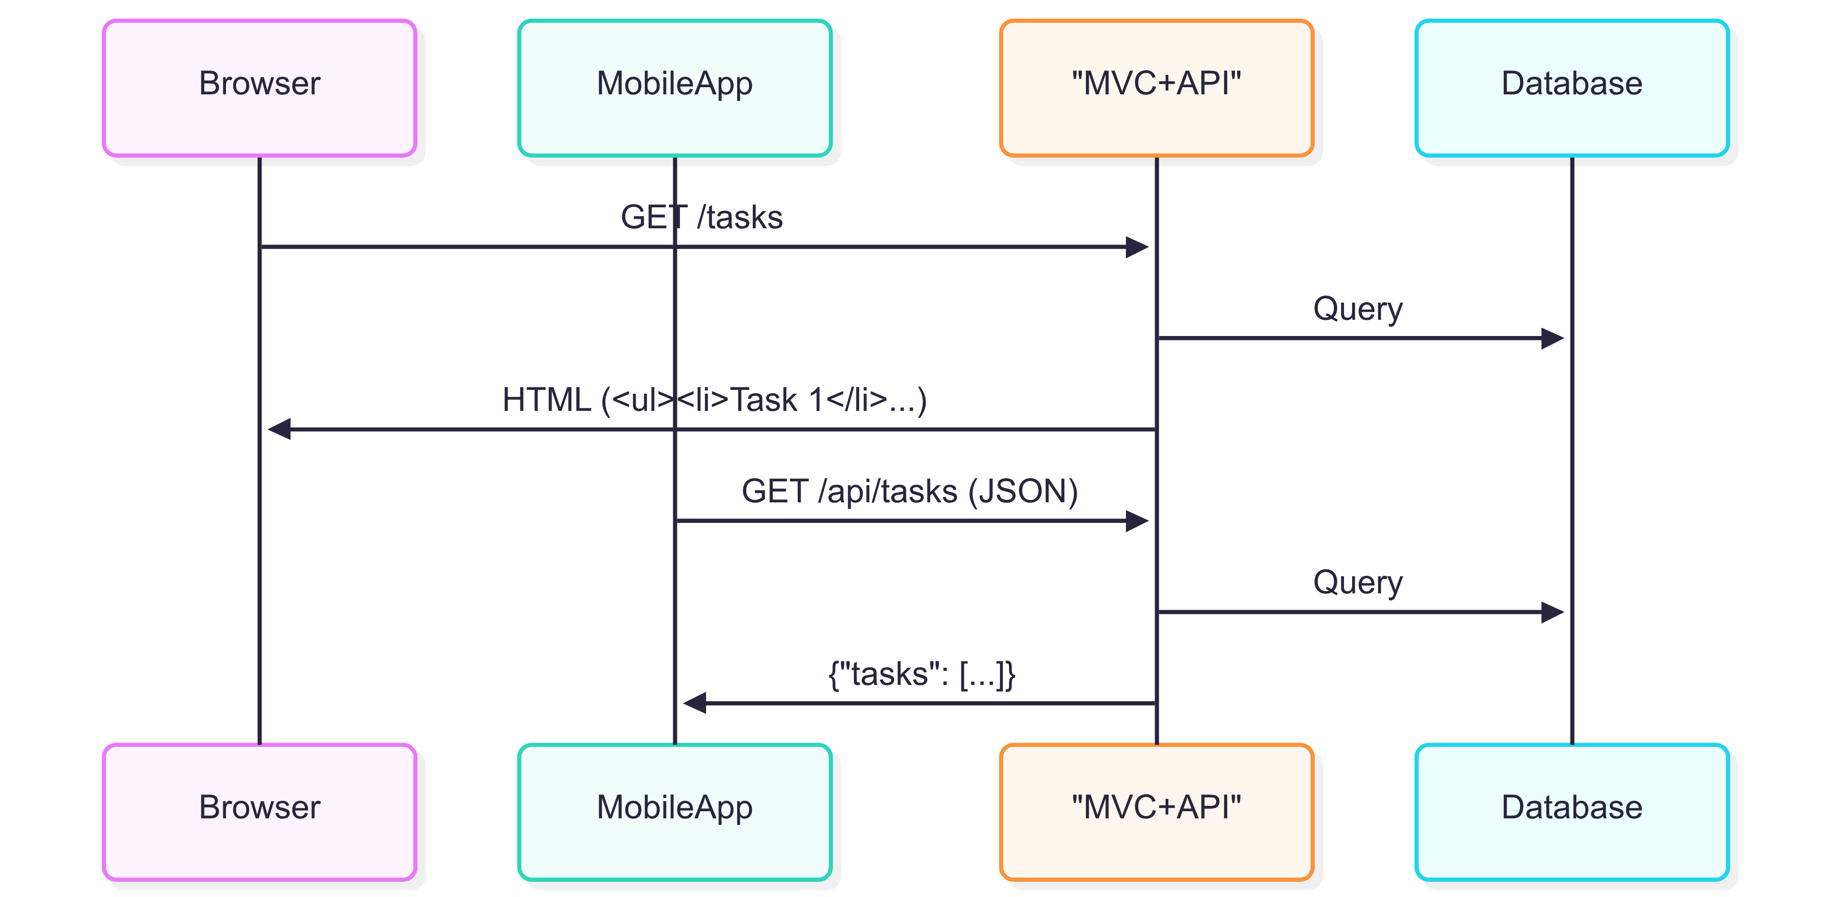
Hybrid (MVC + API)

Slide 9
01
Foundations
API Architectures

Slide 10
API Architectures
Type | Best For
REST | General web/mobile APIs
GraphQL | Client-driven data queries
gRPC | Microservices, high-performance

Slide 11
01
Core Concepts
REST

Slide 12
REST Principles
Core Constraints:
Stateless: Each request must contain all necessary information (like JWT tokens) – the server doesn’t store client state between requests.
Resource-based: API endpoints (e.g., /api/TodoTasks) represent nouns (resources), not actions (verbs).
HTTP Verbs: GET/POST/PUT/DELETE

Slide 13
01
Core Concepts
HTTP

Slide 14
HTTP Verbs (CRUD Mapping)
VERB | CRUD
GET | Read
POST | Create
PUT | Update
DELETE | Delete
PATCH | Partial Update

Slide 15

Essential Status Codes
Code Range | Type | Examples
2xx | Success | Ok (200), Created (201), No Content (204(
3xx | Redirection | ---------------------
4xx | Client Error | Bad Request (400), Unauthorized (401), Forbidden (403), Not Found (404)
5xx | Server Error | Internal Error - Unhandled exception (e.g., DB connection failure)

Slide 16
Request Anatomy
Component | Contains | Examples
Headers | Metadata | Authorization: Bearer <JWT>, Content-Type: application/json
Path | Resource location | /api/TodoTasks/1
Query | Filtering/Sorting | ?isDone=true&page=2
Body | Data (for POST/PUT) | CreateTodoTaskDto JSON

Slide 17
Response Anatomy
Component | Contains | Examples
Status | Code + message | 200 OK
Headers | Metadata | Content-Type: application/json
Body | Data (if any) | PaginatedResponseDto<TodoTask>

Slide 18
01
Core Concepts
Middleware vs ActionFilter

Slide 19
Middleware vs ActionFilter
Aspect | Middleware | Filter
Scope | Entire HTTP request/response pipeline | Specific controller/action
Execution | Runs on every request | Runs only for matching actions
Order | Defined in Program.cs pipeline | Attribute-based

Slide 20


Middleware vs ActionFilter
Code Examples:
Middleware: `app.UseAuthentication()` in Program.cs
Filter: `[Authorize(Roles = "AppAdmin")]` in controllers

Slide 21

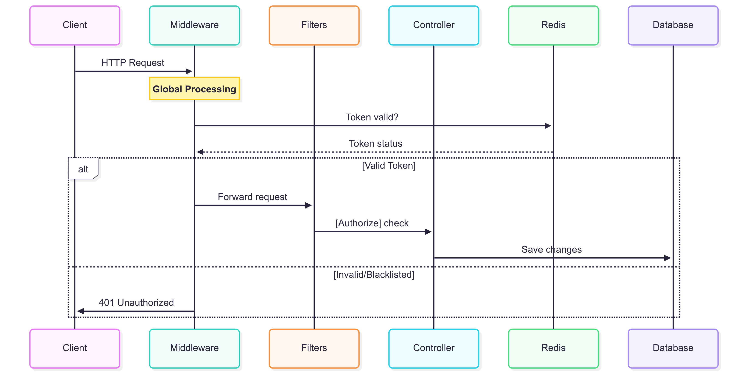

Slide 22
01
Implementation
Project Structure

Slide 23
Project/
├── Controllers/ # Endpoints
├── Services/ # Business logic
├── Data/ # Models & DbContext
├── DTOs/ # Data contracts
└── Migrations/ # Database schema

Slide 24
01
Hands-on

Slide 25
Transform MVC controller into an API controller:
- Remove ViewResult return types
- Return JSON (IActionResult, Ok(), etc.)

Slide 26
01
Break !

Slide 27
01
Security
Auth Methods

Slide 28
Authentication Methods
Method | Use Case
JWT | SPA/Mobile apps
OAuth | Third-party login
Cookies | Browser-based apps
API Keys | Service-to-service

Slide 29
JWT Advantages:
Stateless
Self-contained claims
Easy to validate

Slide 30
JWT Structure:
Header (Algorithm & Token Type)
Payload (Claims)
{
"nameid": "123", ...,
"jti": "a1b2c3d4", // Unique token ID (for blacklisting)
"role": "AppAdmin", // Only if user.IsAdmin
"exp": 1735689600 // Expiration (30 mins from appsettings.json)
}
Signature

Slide 31
01
Tooling
Swagger

Slide 32
What’s Swagger?
A framework for describing and documenting APIs.
Generates an interactive UI for testing endpoints.
Provides OpenAPI specification. (A standard format for describing REST APIs.)

Slide 33
Why API Documentation Matters
Acts as a contract between backend & frontend.
Reduces miscommunication in teams.
Makes it easy to explore & test APIs.

Slide 34
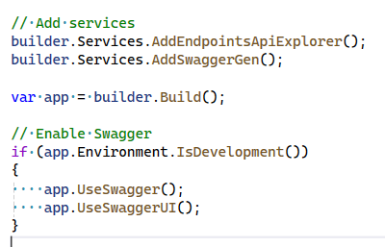
How to enable it?

Slide 35
01
Tooling
Postman

Slide 36
What’s Postman?
Manual/External testing tool for any API.

Slide 37
Project Announcement

Slide 38

Thanks!
https://www.linkedin.com/in/khaled-sayed-mas/

